Slide 1
Naive Bayes Classifier

Slide 2
Introduction – Bayes Theorem
Conditional Probability
Independent Events
Dependent Events

Slide 3
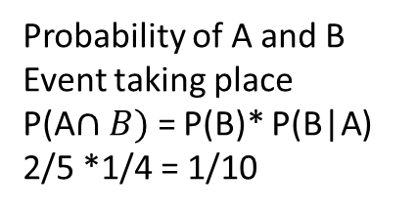
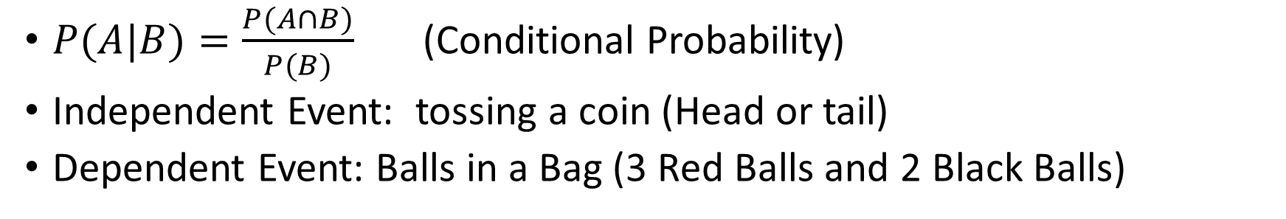
A: Event 1 B : Event 2
$P(A|B)=\frac{P(A∩B)}{P(B)}$ (Conditional Probability)
Independent Event: tossing a coin (Head or tail)
Dependent Event: Balls in a Bag (3 Red Balls and 2 Black Balls)
Probability of Getting Black Ball P(B) = 2/5
Probability of Getting Another Black Ball P(B|A) = 1/4 (Probability of B given A) – A all ready happened
Taking out 1 black ball
Probability of A and B Event taking place
P(A$∩B)$= P(B)* P(B|A)
2/5 *1/4 = 1/10

Slide 4
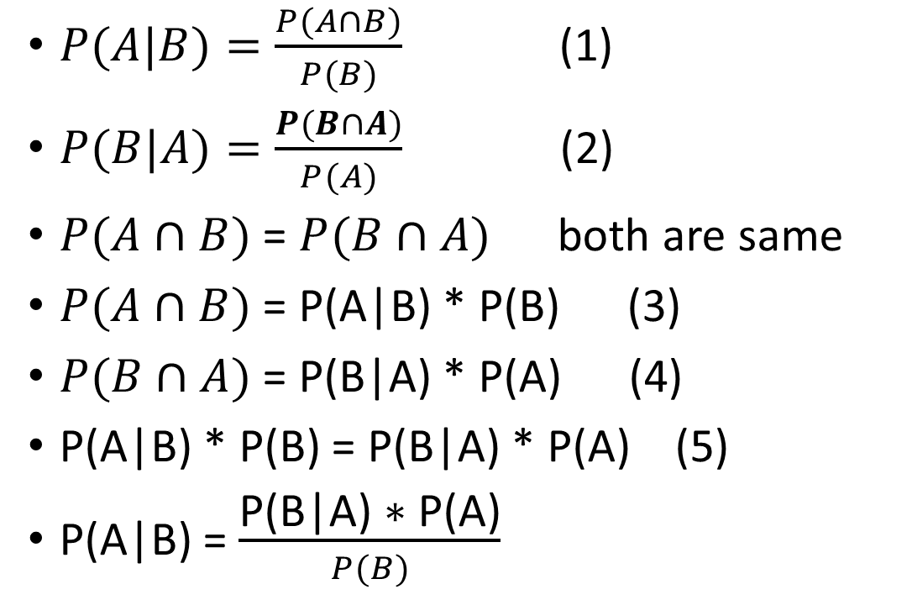
Bayes theorem
In probability theory and statistics, Bayes' theorem (alternatively Bayes' law or Bayes' rule), named after Reverend Thomas Bayes, describes the probability of an event, based on prior knowledge of conditions that might be related to the event.
$P(A|B)=\frac{P(A∩B)}{P(B)}$ (1)
$P(B|A)=\frac{P(B∩A)}{P(A)}$ (2)
$P(A∩B)$ = $P(B∩A)$ both are same
$P(A∩B)$ = P(A|B) * P(B) (3)
$P(B∩A)$ = P(B|A) * P(A) (4)
P(A|B) * P(B) = P(B|A) * P(A) (5)
P(A|B) = $\frac{\text{P}\text{(}\text{B}\text{|}\text{A}\text{) ∗ }\text{P}\text{(}\text{A}\text{)}}{P(B)}$
P(A|B) – Posterior Probability
P(B|A) – Likelihood
P(B) – Marginal Probability
P(A) – Prior Probability

Slide 5
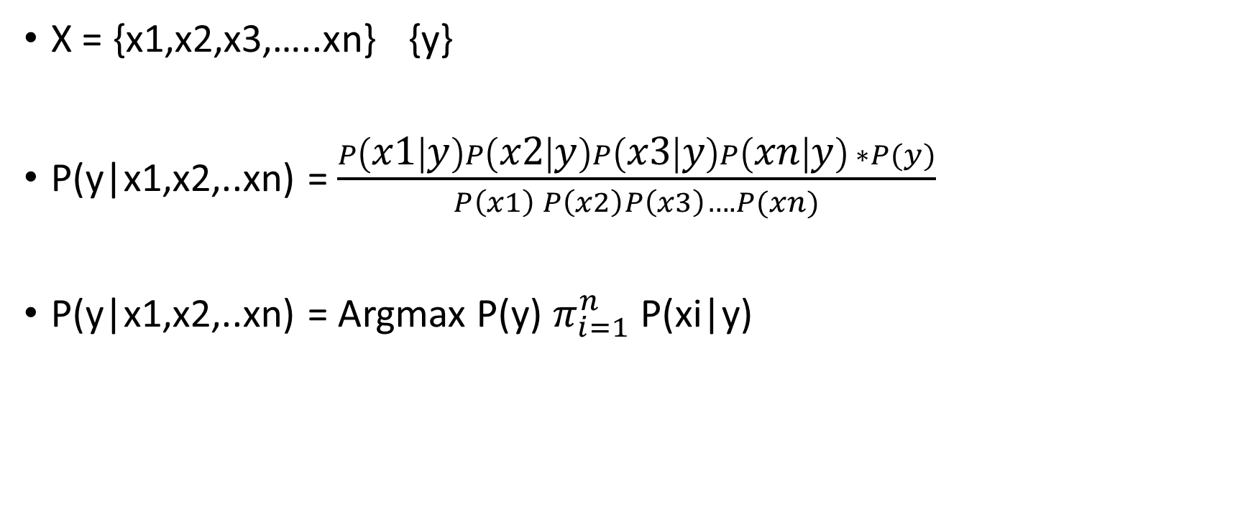
Naïve Bayes Classifier
X = {x1,x2,x3,…..xn} {y}
P(y|x1,x2,..xn) = $\frac{P\left(x1 | y\right)P\left(x2 | y\right)P\left(x3 | y\right)P\left(xn | y\right) ∗P(y)}{P\left(x1\right) P\left(x2\right)P\left(x3\right)….P(xn)}$
P(y|x1,x2,..xn) = Argmax P(y) $π_{i=1}^{n}$ P(xi|y)
Argmax is most commonly used in machine learning for finding the class with the largest predicted probability

Slide 6
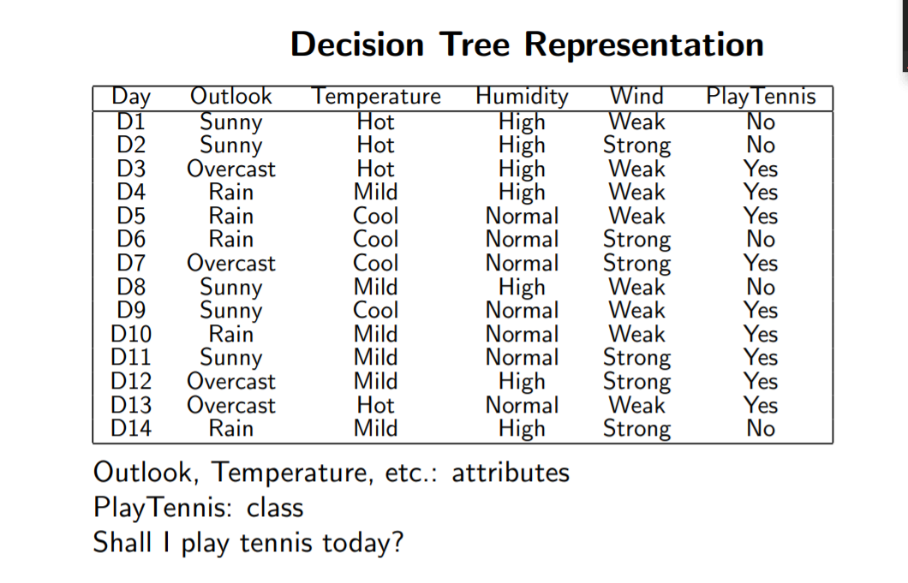
Example

Slide 7
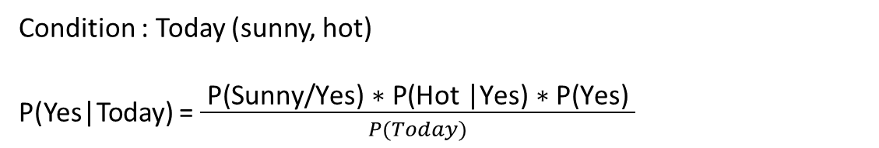
Example
Outlook | Yes | No | P(Y) | P(N)
Sunny | 2 | 3
Overcast | 4 | 0
Rainy | 3 | 2
Total | 9 | 5
Temprature | Yes | No | P(Y) | P(N)
Hot | 2 | 2
Mild | 4 | 2
Cool | 3 | 1
Total | 9 | 5
Condition : Today (sunny, hot)
P(Yes|Today) = $\frac{ \text{P}\text{(}\text{Sunny}\text{/}\text{Yes}\text{) ∗ }\text{P}\text{(}\text{Hot}\text{ |}\text{Yes}\text{) ∗ }\text{P}\text{(}\text{Yes}\text{) }}{P(Today)}$
Play |  | P(Y) & P(N)
Yes | 9
No | 5
Total | 14
=2/9 * 2/9 *9/14 = 0.031
P(No|Today) = 3/5 * 2/5 * 5/14 =0.08571
P(Yes) = 0.031 / 0.031+0.08571 = 0.27
P(No) = 1-0.27 = 0.73

Slide 8
Example
Outlook | Yes | No | P(Y) | P(N)
Sunny | 2 | 3 | 2/9 | 3/5
Overcast | 4 | 0 | 4/9 | 0/5
Rainy | 3 | 2 | 3/9 | 2/5
Total | 9 | 5 | 100% | 100%
Temprature | Yes | No | P(Y) | P(N)
Hot | 2 | 2 | 2/9 | 2/5
Mild | 4 | 2 | 4/9 | 2/5
Cool | 3 | 1 | 3/9 | 1/5
Total | 9 | 5 | 100% | 100%
Condition : Today (sunny, hot)
P(Yes|Today) = $\frac{ \text{P}\text{(}\text{Sunny}\text{/}\text{Yes}\text{) ∗ }\text{P}\text{(}\text{Hot}\text{ |}\text{Yes}\text{) ∗ }\text{P}\text{(}\text{Yes}\text{) }}{P(Today)}$
Play |  | P(Y) & P(N)
Yes | 9 | 9/14
No | 5 | 5/14
Total | 14 | 100%
2/9 * 2/9 *9/14 = 0.031
P(No|Today) = 3/5 * 2/5 * 5/14 =0.08571
P(Yes) = 0.031 / 0.031+0.08571 = 0.27
P(No) = 1-0.27 = 0.73

Slide 9
According to NB algorithm:
1.Gaussian NB: It should be used for features in decimal form. GNB assumes features to follow a normal distribution.
2.MultiNomial NB: It should be used for the features with discrete values like word count 1,2,3...
3.Bernoulli NB: It should be used for features with binary or boolean values like True/False or 0/1.

